Slide 1
Lecture Zero Security Framework
Dr. M. Mahfuzul Islam
Professor, Dept. of CSE, BUET

Slide 2
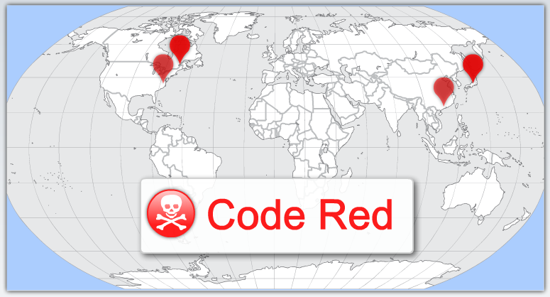
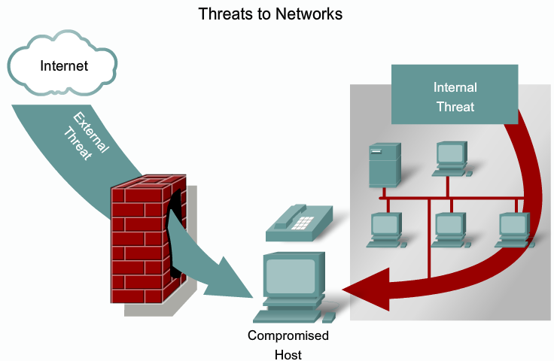
Evolution of Security
System Security is ultimately the responsibility of everyone that uses it.
In July 2001, the Code Red worm attacked web servers globally, infecting over 350,000 hosts.
Security is to protect system from any unauthorized access.
Internal threats can cause even greater damage than external threats.
Protection System describes the conditions under which a system is secure.

Slide 3
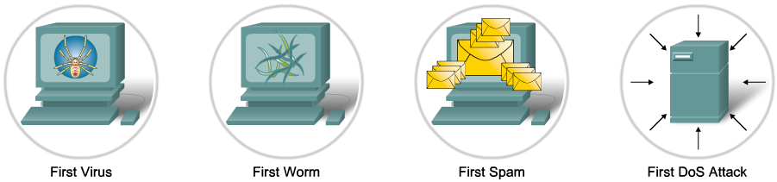
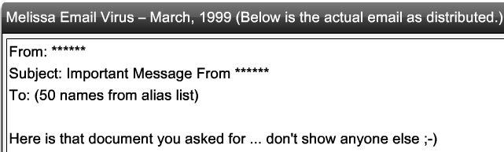
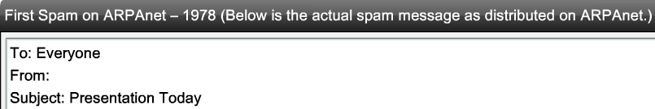
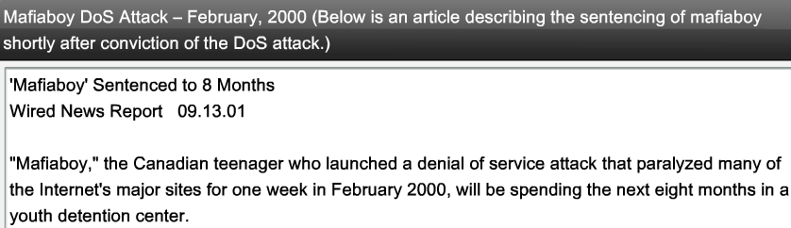

Security Drivers

Slide 4

Evolution of Security
Three Dimensions of Security:
Confidentiality: concealment of information or resources.
Prevent the disclosure of sensitive information from unauthorized people, resources, and processes.
Access control mechanisms and Resource hiding supports confidentially.
Availability: the ability to use the information or resources desired.
The assurance that systems and data are accessible by authorized users when needed.
Availability is an important aspect of reliability.
Attempts to block availability, called DOS attack is the most difficult to detect, if unusual access patterns are attributable to deliberate manipulation of resources ot of environment.

Slide 5
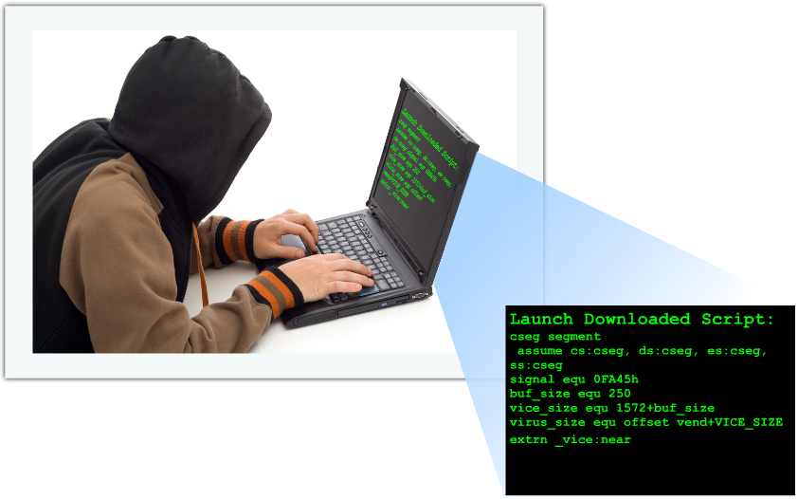
Evolution of Security
Integrity: Trustworthiness of data and resources.
The protection of system information or processes from intentional or accidental modification.
Integrity includes data integrity (the contents of information) and origin integrity (the source of data often called authentication). The source of information may bear on its accuracy and credibility.
Integrity mechanisms fall into two classes: Prevention Mechanism and detection mechanism (report that the data integrity is no longer trustworthy).
Prevention blocks any unauthorized attempts to change the data (lack of authentication) or any attempts to change the data in unauthorized way (lack of authorization)
Hackers
Negative
Positive
Hacking is a driving force in network security.

Slide 6
Threats
Threats: Potential violation of security.
Attacks: Actions that could cause violation of security.
Threats can be divided into four broad classes:
Disclosure: unauthorized access of information.
Deception: acceptance of false data.
Disruption: Interruption or prevention of correct operation.
Usurpation: Unauthorized control of some part of a system.
Hackers
Negative
Positive
Hacking is a driving force in network security.

Slide 7
Threats
Some Important threats are:
Snooping: unauthorized interception of information.
Passive wiretapping: Listening to communications or browsing files or system information.
Active wiretapping: Modification or alteration of information, e.g., the man-in the middle attack.
Masquerading or spoofing: Impersonation of one entity by another. Delegation occurs when one entity authorizes a second entity to perform functions on its behalf. Masquerading is a violation of security whereas delegation is not.
Passive masquerading: does not attempt to authenticate the recipient but merely accesses it.
Active masquerading: Masquerader issues response to mislead the user about its identity.
Repudiation of origin: A false denial that an entity sent (or created) something.
Denial of receipt: a false denial that an entity received some information or message.
Delay: a temporary inhibition of a service. This requires manipulation of system control structures, such as network components or server components.
Denial of Service (DoS): a long term inhibition of a service. This an infinite delay.

Slide 8
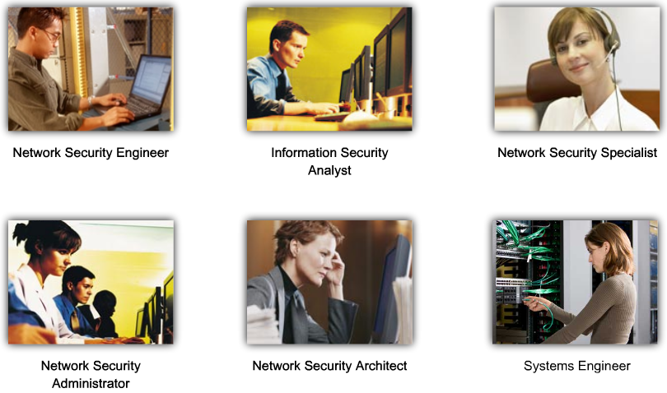
Security professionals

Slide 9
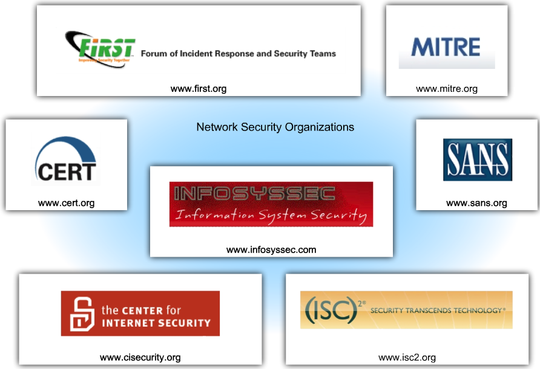
Security Organizations
www.infosyssec.com
www.sans.org
www.cisecurity.org
www.cert.org
www.isc2.org
www.first.org
www.infragard.net
www.mitre.org
www.cnss.gov

Slide 10

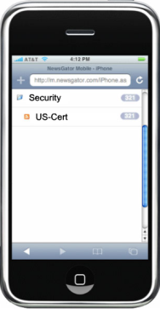
Security Certifications
Information security certifications Offered by (ISC)2
Systems Security Certified Practitioner (SCCP)
Certification and Accreditation Professional (CAP)
Certified Secure Software Lifecycle Professional (CSSLP)
Certified Information Systems Security Professional (CISSP)

Slide 11
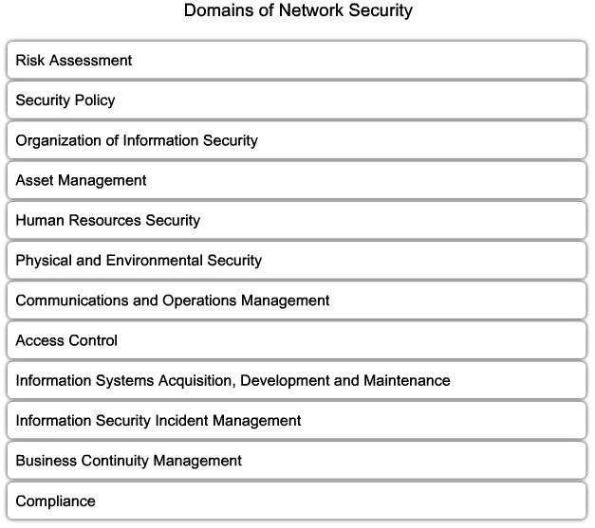
Domains of Security
ISO/IEC 17799

Slide 12




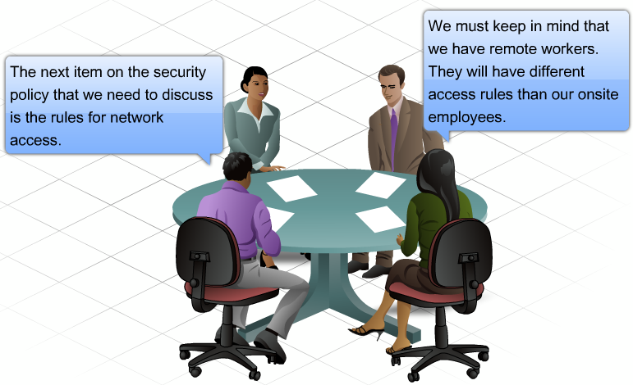
Security Policy
A document that states how an organization plans to protect its tangible and intangible information assets
Management instructions indicating a course of action, a guiding principle, or appropriate procedure
High-level statements that provide guidance to workers who must make present and future decisions
Generalized requirements that must be written down and communicated to others
Security policy outlines:
Rule of system access: Establishes a hierarchy of access permissions.
How policies are enforced
Describes the basic architecture of the organization’s system security environment

Slide 13
Documents Supporting Security Policies
Standards – dictate specific minimum requirements in our policies
Guidelines – suggest the best way to accomplish certain tasks
Procedures – provide a method by which a policy is accomplished (the instructions)
Subsection | 6.1 PERSONNEL SECURITY Change Control #: 1.0
Policy | 6.1.3 Confidentiality Agreements Approved by: SMH
Objectives | Confidentiality of organizational data is a key tenet of our information security program. In support of this goal, ABC Co will require signed confidentiality agreements of all authorized users of information systems. This agreement shall conform to all federal, state, regulatory, and union requirements.
Purpose | The purpose of this policy is to protect the assets of the organization by clearly informing staff of their roles and responsibilities for keeping the organization’s information confidential.
Audience | ABC Co confidentiality agreement policy applies equally to all individuals granted access privileges to an ABC Co Information resources
Policy | This policy requires that staff sign a confidentiality policy agreement prior to being granted access to any sensitive information or systems. Agreements will be reviewed with the staff member when there is any change to the employment or contract, or prior to leaving the organization. The agreements will be provided to the employees by the Human Resource Dept.
Exceptions | At the discretion of the Information Security Officer, third parties whose contracts include a confidentiality clause may be exempted from signing individual confidentiality agreements.
Disciplinary Actions | Violation of this policy may result in disciplinary actions, which may include termination for employees and temporaries; a termination of employment relations in the case of contractors or consultants; or dismissal for interns and volunteers. Additionally, individuals are subject to civil and criminal prosecution.

Slide 14
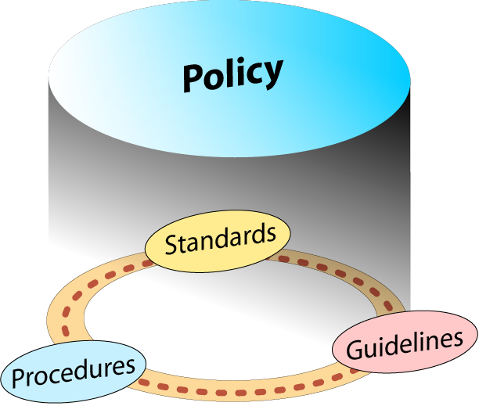
Example: Policy for password use
Policy:
All users must have a unique user ID and password that conforms to the company password standard
Users must not share their password with anyone regardless of title or position
Passwords must not be stored in written or any readable form
If a compromise is suspected, it must be reported to the help desk and a new password must be requested
Standards:
Minimum of 8 upper- and lowercase alphanumeric characters
Must include a special character
Must be changed every 30 days
Password history of 24 previous passwords will be used to ensure passwords aren’t reused

Slide 15
Example: Policy for password use
The Guideline:
Take a phrase
Up and At ‘em at 7!
Convert to a strong password
Up&atm@7!
To create other passwords from this phrase, change the number, move the symbol, or change the punctuation mark
Procedure for changing a password
Press Control, Alt, Delete to bring up the log in dialog box
Click the “change password” button
Enter your current password in the top box
…

Slide 16
The OSI Security Architecture
Security Attack: An action that compromises the security of information owned by an organization.
Security Mechanism: A process (or a device incorporating such a process) that is designed to detect, prevent or recover from a security attack.
Security Service: A processing or communication service that enhances the security of the data processing systems and the information transfer of an organization.
Threat: A potential for violation of security, which exits when there is a circumstance, capability, action, or event that could breach security and cause harm.
Attack: An assault on system security that derives from an intelligent threat.
i.e., an intelligent act that is a deliverable attempt to evade security services and violet the security policy of a system
Threat and Attack (RFC 2828)

Slide 17
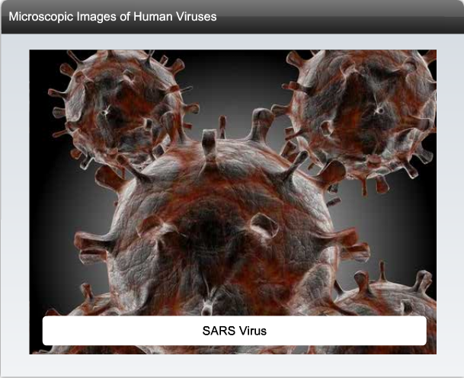


Security Attacks
Virus: A malicious software which attaches to another program to execute a specific unwanted function on a computer.
Worm: executes arbitrary code and installs copies of itself in the memory of the infected computer, which then infects other hosts.
Trojan Horse: An application written to look like something else. When a Trojan Horse is downloaded and opened, it attacks the end-user computer from within.

Slide 18
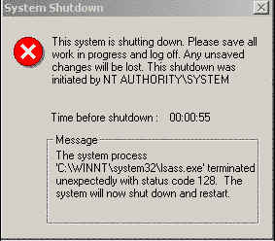
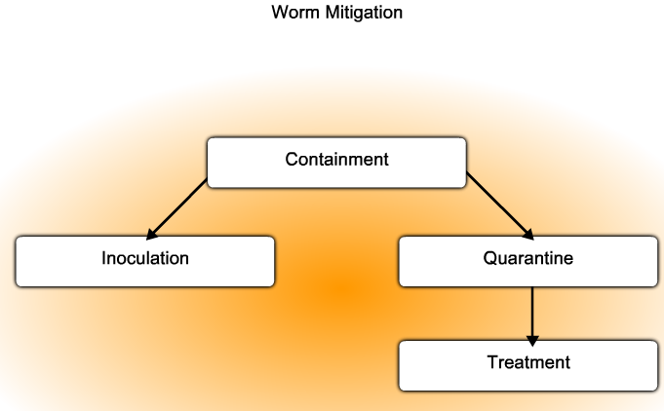
Security Attacks
Three major components to most worm attacks:
Enabling vulnerability - A worm installs itself using an exploit mechanism (email attachment, executable file, Trojan Horse) on a vulnerable system.
Propagation mechanism - After gaining access to a device, the worm replicates itself and locates new targets.
Payload - Any malicious code that results in some action. Most often this is used to create a backdoor to the infected host.
Response to a worm infection:
Containment - A policy for checking the expansion of worm to other files or devices.
Inoculation- Increase computer’s Immunity.
Quarantine- Separate infected files.
Treatment- disinfect the worm from the files.

Slide 19
Security Attacks
The term Trojan Horse originated from Greek mythology.
A Trojan Horse in the world of computing is malware software.
“Spread” via human engineering or by manually emailing.
It does not replicate itself, and it does not infect other files.
Classification of Trojan horse:
Remote-access Trojan Horse (enables unauthorized remote access)
Data sending Trojan Horse (provides the attacker with sensitive data such as passwords)
Destructive Trojan Horse (corrupts or deletes files)
Proxy Trojan Horse (user's computer functions as a proxy server)
FTP Trojan Horse (opens port 21)
Security software disabler Trojan Horse (stops anti-virus programs or firewalls from functioning)
Denial of Service Trojan Horse (slows or halts network activity)

Slide 20
Attack Methodologies
Reconnaissance Attacks
unauthorized discovery and mapping of systems, services, or vulnerabilities.
Access Attacks
exploit known vulnerabilities in authentication services, FTP services, and web services.
Denial of Service Attacks
send extremely large numbers of requests over a network or the Internet.

Slide 21

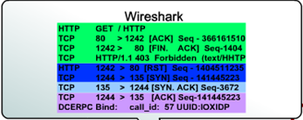
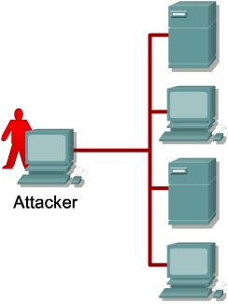

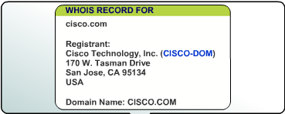

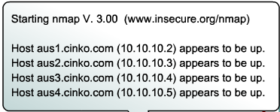

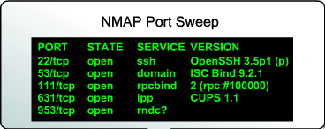

Reconnaissance Attacks
Reconnaissance attacks are the precursor to further attacks.
Various tools are used to gain access to a network
Packet Sniffers
Ping Sweeps
Port Scans
Internet Information Queries
Some network packets in unencrypted plaintext.
Numerous freeware and shareware packet sniffers.

Slide 22
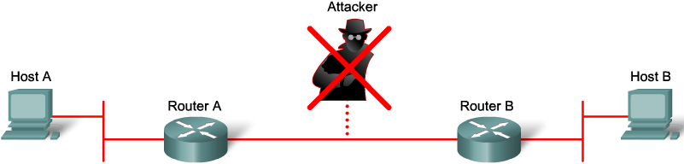
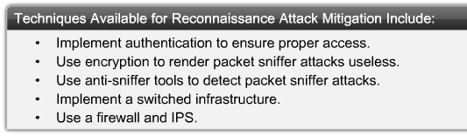
Reconnaissance Attacks
Reconnaissance Attacks can be mitigated in several ways:

Slide 23
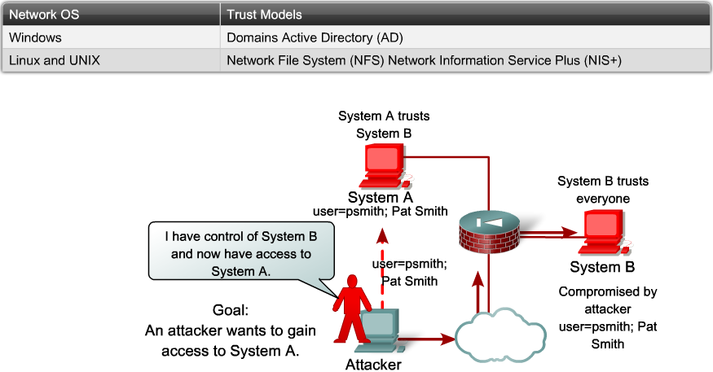
Access Attacks
Five types of access attacks:
Password attack
Trust exploitation
Port redirection
Man-in-the-middle attack
Buffer overflow
Three methods for password attacks
Brute-force attacks
Trojan Horse Programs
Packet sniffers
Trust exploitation

Slide 24
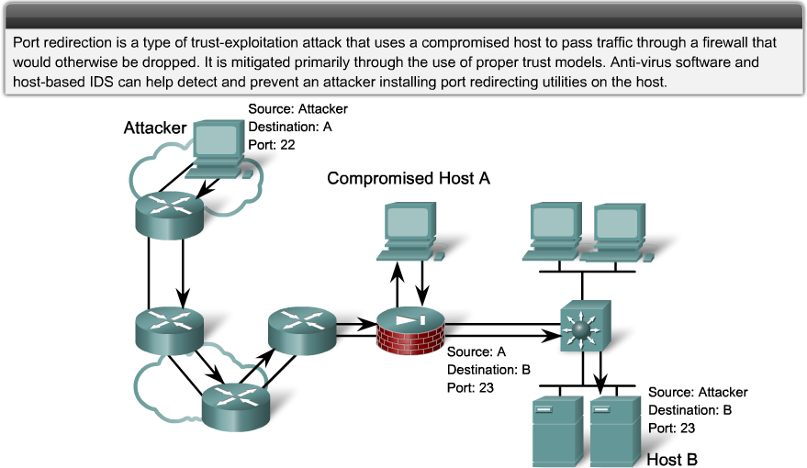
Access Attacks
Port Redirection

Slide 25
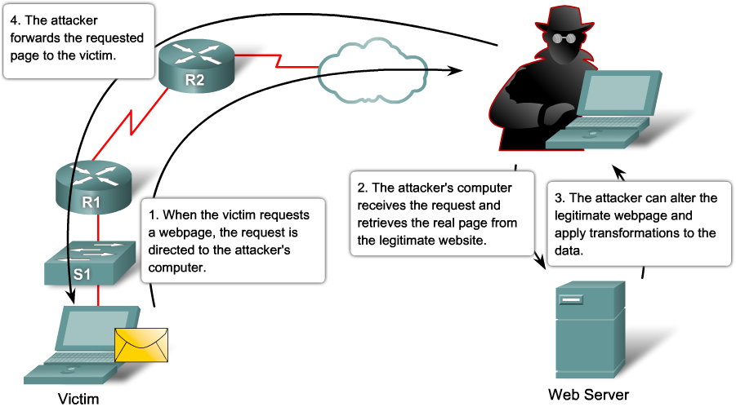
Access Attacks
Man-in-the-middle attack

Slide 26
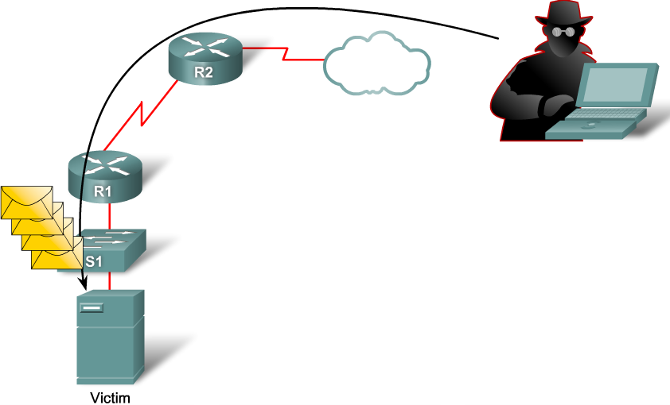
Access Attacks
Buffer Overflow Attack
Detect the Access Attacks:
Reviewing logs: Check the numbers of failed login attempts.
Reviewing logs: Check the numbers of failed login attempts.
Bandwidth utilization: Detect the Man-in-the-middle attacks.
Process loads: Detect the buffer overflow attacks.

Slide 27
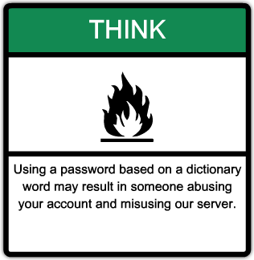
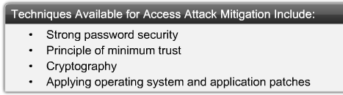
Access Attacks
Several techniques are available for mitigating access attacks.
Strong password policy:
Disabling accounts after a specific number of unsuccessful logins. This practice helps to prevent continuous password attempts.
Not using plaintext passwords. Use either a one-time password (OTP) or encrypted password.
Using strong passwords. Strong passwords are at least eight characters and contain uppercase letters, lowercase letters, numbers, and special characters.

Slide 28
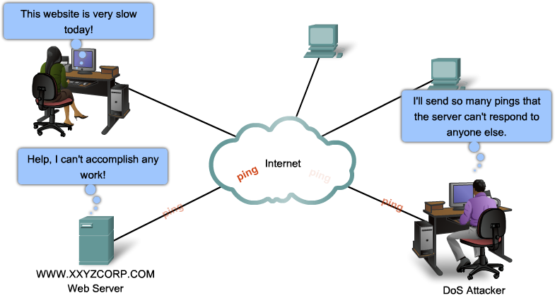
Denial of Service (DoS) Attacks
A DoS attack is a network attack
compromise the availability of a network, host, or application
There are two major reasons a DoS attack occurs:
A host or application fails to handle an unexpected condition.
A network, host, or application is unable to handle an enormous quantity of data.

Slide 29
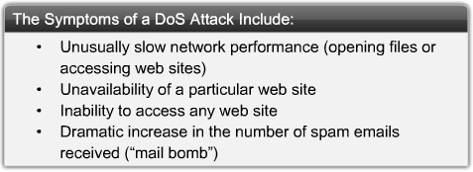

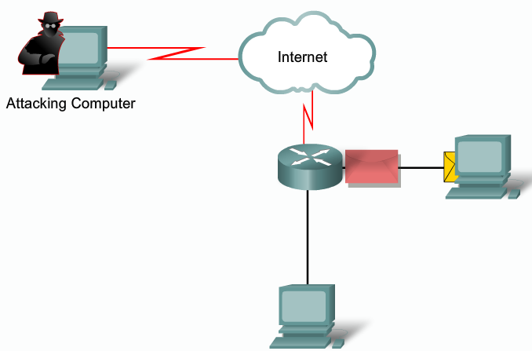
Denial of Service (DoS) Attacks
Some examples of DoS attacks
Ping of death attack
Smurf Attack
TCP SYN Flood attack
email attack
Physical Infrastructure attacks
Ping of death attack
A hacker sends an echo request in an IP packet larger than the maximum packet size of 65,535 bytes
ping -t -l 65550 192.168.1.1

Slide 30
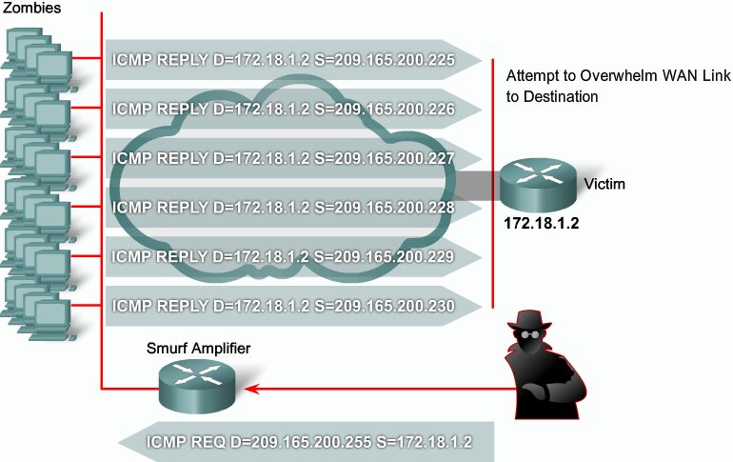
Denial of Service (DoS) Attacks
Smurf Attack

Slide 31
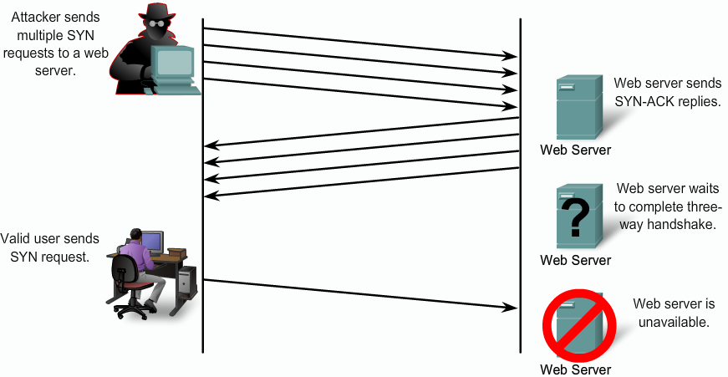
Denial of Service (DoS) Attacks
TCP SYN Flood attack

Slide 32


Denial of Service (DoS) Attacks
email attack:
When using Microsoft Outlook, a script reads your address book and sends a copy of itself to everyone listed there, thus propagating itself around the Internet.
The script then modifies the computer’s registry so that the script runs itself again when restarted.
Physical infrastructure attack:
Someone can just simply snip your cables! Fortunately this can be quickly noticed and dealt with.
Other physical infrastructure attacks can include recycling systems, affecting power to systems and actual destruction of computers or storage devices.

Slide 33
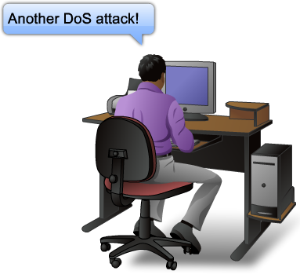
Denial of Service (DoS) Attacks
To date, hundreds of DoS attacks have been documented.
There are five basic ways that DoS attacks can do harm:
Consumption of computational resources, such as bandwidth, disk space, or processor time
Disruption of configuration information, such as routing information
Disruption of state information, such as unsolicited resetting of TCP sessions
Disruption of physical network components
Obstruction of communication between the victim and others.
Mitigating DoS attack: Mitigating DoS attacks requires careful diagnostics, planning, and cooperation from Firewalls and ISPs.
Firewalls and IPS
Anti-spoofing technologies
Quality of Service – traffic policing

Slide 34
Security Attacks
Social Engineering attacks:
Hacker-speak for tricking a person into revealing some confidential information
An attack based on deceiving users or administrators at the target site
Done to gain illicit access to systems or useful information
The goals of social engineering are fraud, network intrusion, industrial espionage, identity theft, etc.
Few most popular tools used by network attackers:
Enumeration tools (dumpreg, netview and netuser)
Port/address scanners (AngryIP, nmap, Nessus)
Vulnerability scanners (Meta Sploit, Core Impact, ISS)
Packet Sniffers (Snort, Wire Shark, Air Magnet)
Root kits
Cryptographic cracking tools (Cain, WepCrack)
Malicious codes (worms, Trojan horse, time bombs)
System hijack tools (netcat, MetaSploit, Core Impact)

Slide 35
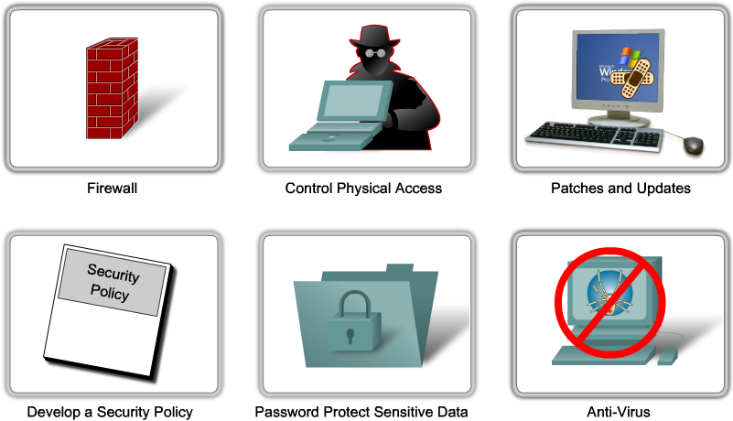
Best 10 practices for mitigating attacks
1. Keep patches up to date by installing them weekly or daily, if possible, to prevent buffer overflow and privilege escalation attacks.
2. Shut down unnecessary services and ports.
3. Use strong passwords and change them often.
4. Control physical access to systems.
5. Avoid unnecessary web page inputs.
6. Perform backups and test the backed up files on a regular basis.
7. Educate employees about the risks of social engineering, and develop strategies to validate identities over the phone, via email, or in person.
8. Encrypt and password-protect sensitive data.
9. Implement security hardware and software firewalls, IPSs, virtual private network (VPN) devices, anti-virus software, and content filtering.
10. Develop a written security policy for the company.

